Slide 1

[Requirements Engineering] Agile Workflow
(Chapter 04)
MIS 372 Spring 2022

Slide 2

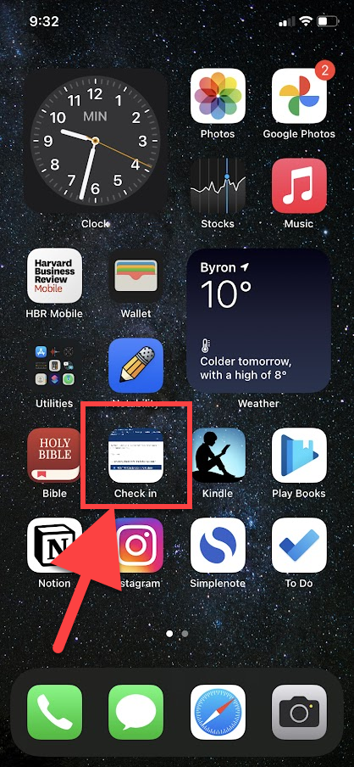
Check-in Page:
https://forms.office.com/r/nwsEdTduTE
Add Check-in Page to Your Phone’s Home Screen
iPhones: https://youtu.be/zJZ-B-Ey7IY
Android: https://youtu.be/7leTSJU5ATU

Slide 3
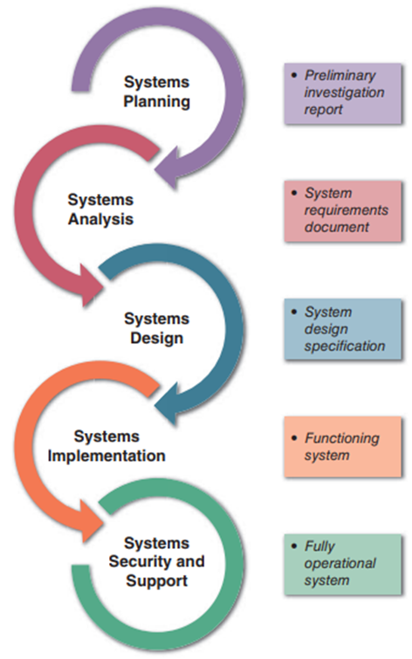
Where We Are in SDLC

Slide 4
Learning Objectives
1. Agile Values and Principles
2. Agile Practices – Scrum
3. User Stories and the Workflow

Slide 5
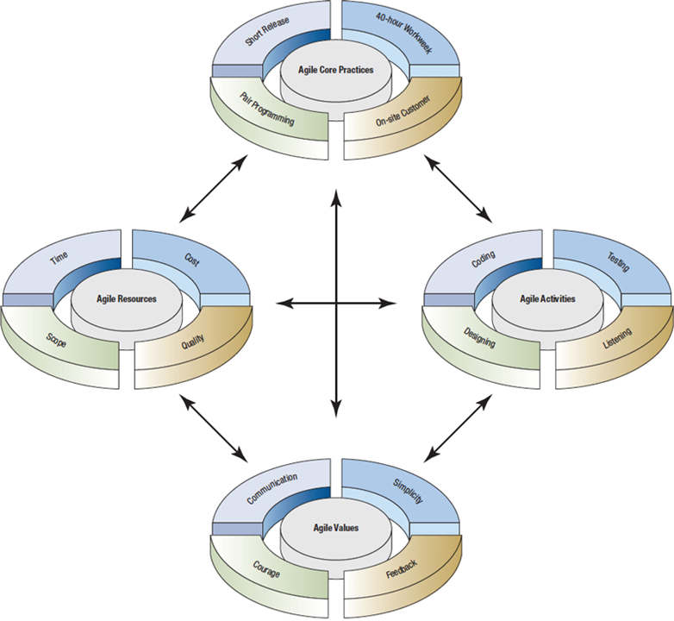
Agile methods are a collection of innovative, user-centered approaches to systems development.

Slide 6
1. Agile Values
Agile Values
Commun-ication
Simplicity
Feedback
Courage
Four values create an environment in which both developers and businesses can adequately be served.

Slide 7

The Basic Principles of Agile Modeling
Satisfy the customer through delivery of working software
Embrace change, even if introduced late in development
Continue to deliver functioning software incrementally and frequently
Encourage customers and analysts to work together daily
Trust motivated individuals to get the job done

Slide 8
The Basic Principles of Agile Modeling (cont.)
Promote face-to-face conversation
Concentrate on getting software to work
Encourage continuous, regular, and sustainable development
Adopt agility with attention to mindful design
Support self-organizing teams

Slide 9
The Basic Principles of Agile Modeling (cont.)
Provide rapid feedback
Encourage quality
Review and adjust behavior occasionally
Adopt simplicity

Slide 10
Four Basic Activities of Agile Modeling
Basic Activities
Coding
Testing
Listening
Designing
“learning”
“evolutionary, flexibility, simplicity, proximity to data logic”
“confidence in short term;
system longevity in long term”
“less reliance on formal communications”
“developers assume zero knowledge”

Slide 11
The Agile Development Process
Listen for user stories
Draw a logical workflow model
Create new user stories based on the logical model
Develop some display prototypes
Create a physical data model using feedback from the prototypes and logical workflow diagrams

Slide 12
Writing User Stories
Spoken interaction between developers and users
Seeking first and foremost to identify valuable business user requirements
The goal is prevention of misunderstandings or misinterpretations of user requirements

Slide 13
2. Scrum
Scrum is a framework for developing, delivering, and sustaining products in a complex environment.
Begin the project with a high-level plan that can be changed on the fly
Project leader has some (not much) influence on the detail
Systems team works within a strict time frame (two to four weeks for development)

Slide 14
Roles Played in Scrum
There are three roles in Scrum:
Product owner – project creator
Scrum Master – project manager & coach & support
Team member
Work to create and improve user stories
Generate estimates
Self-organize to complete the work
Exhibit willingness to participate in any activity to help the project

Slide 15
Scrum Activities
Product backlog
Sprint backlog
Sprint
Daily scrum
Demo

Slide 16
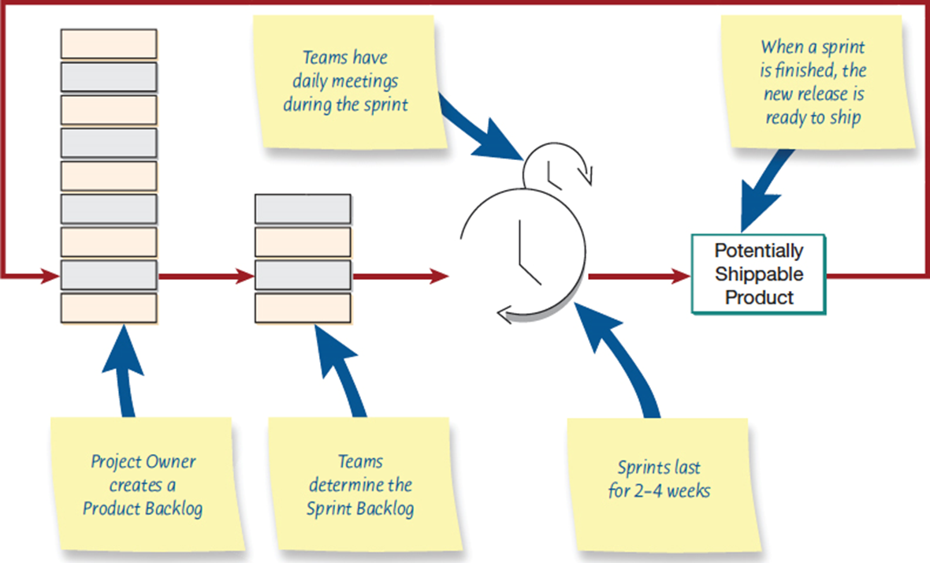
Scrum Workflow – A Sprint Cycle

Slide 17
Product Backlog
Features and other deliverables designers intend for the product based on user stories
The list of user stories is reorganized so that the most important user stories appear on the top

Slide 18
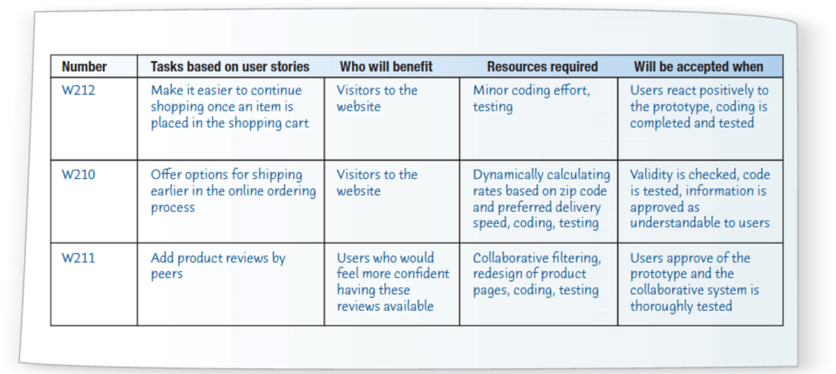
A Product Backlog Registry

Slide 19
Sprint Cycle
Stories are deliverables the team accomplishes
Tasks are parts of the story or units of work that each team members does
The sprint cycle can vary in length, but the usual is two weeks
At the end of the cycle, determine whether the product should be released

Slide 20
3. User Stories
A user story is an informal, natural language description of features of a software system.
They are written from the perspective of an end user or user of a system.
Finer-grain narratives that set out in a more detailed and structured way a single thing that a user wants from a software system.

Slide 21
3Cs in User Stories
Card
Stories are traditionally written on note cards
Cards may be annotated with estimates, notes, etc.
Conversation
Details behind the story come out during conversations with product owner
Confirmation
Acceptance tests confirm a story was coded correctly.

Slide 22
User Story Format
This story reflects what has become the standard format of a user story:
As a <role>, I <want | need> to <do something>
As a teacher, I want to tell all members of my group when new information is available
A variant of this standard format adds a justification for the action:
As a <role> I <want | need> to <do something> so that <reason>
As a teacher, I need to be able to report who is attending a class trip so that the school maintains the required health and safety records.

Slide 23
User Story Example: Back of Card
Confirmation
Success
Display a solid purple check message next to the message.
Failure – Display Message:
“Recipient is not recognized”
“Service unavailable, please try again”
“Account has expired”

Slide 24
How Detailed Should a User Story Be?
Detail enough for the team to start work from, and further details to be established and clarified at the time of development.
If the story is about a more complex feature that might take several sprints to implement, then it is called an epic.
As a system manager, I need a way to backup the system and restore either individual applications, files, directories or the whole system.

Slide 25
Feature description using user stories
Stories can be used to describe features in your product that should be implemented.
Each feature can have a set of associated stories that describe how that feature is used.

Slide 26
User stories describing the Groups feature

Slide 27
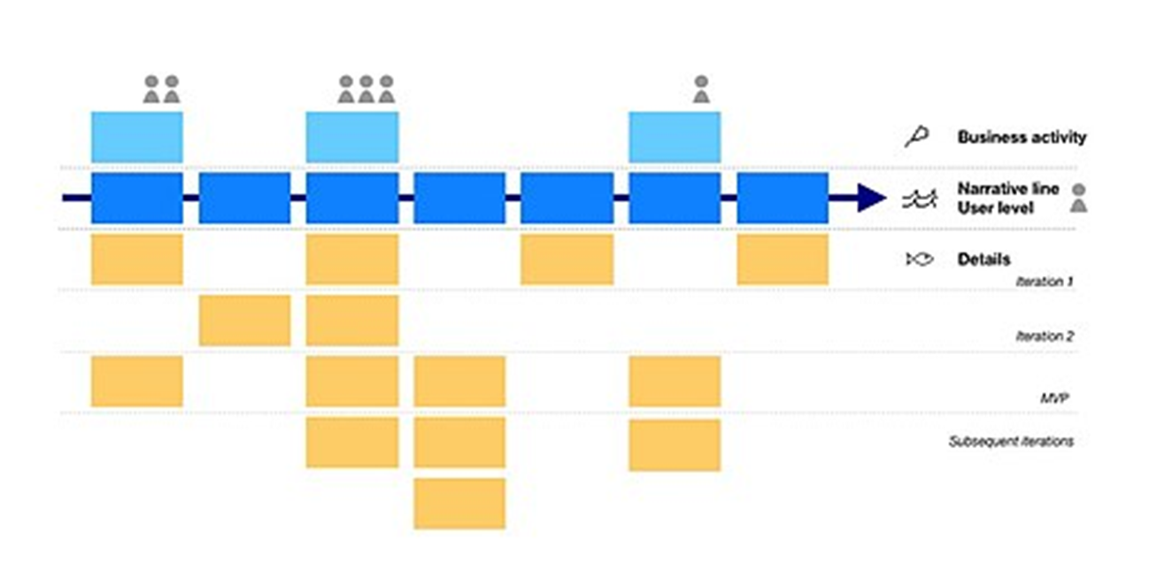
Story Map
A story map organizes user stories according to a narrative flow that presents the big picture of the product.

